Slide 1
Agenda:
Market Segmentation
DGPB Exercise
Shark Tank Exercise

Slide 2
Market Segmentation
The key to marketing is to know your customer or target market. Market segmentation helps identify the target market.

Slide 3
Market Segmentation
market segmentation
demographics
disposable income
discretionary income
geographics
psychographics
mass marketing

Slide 4


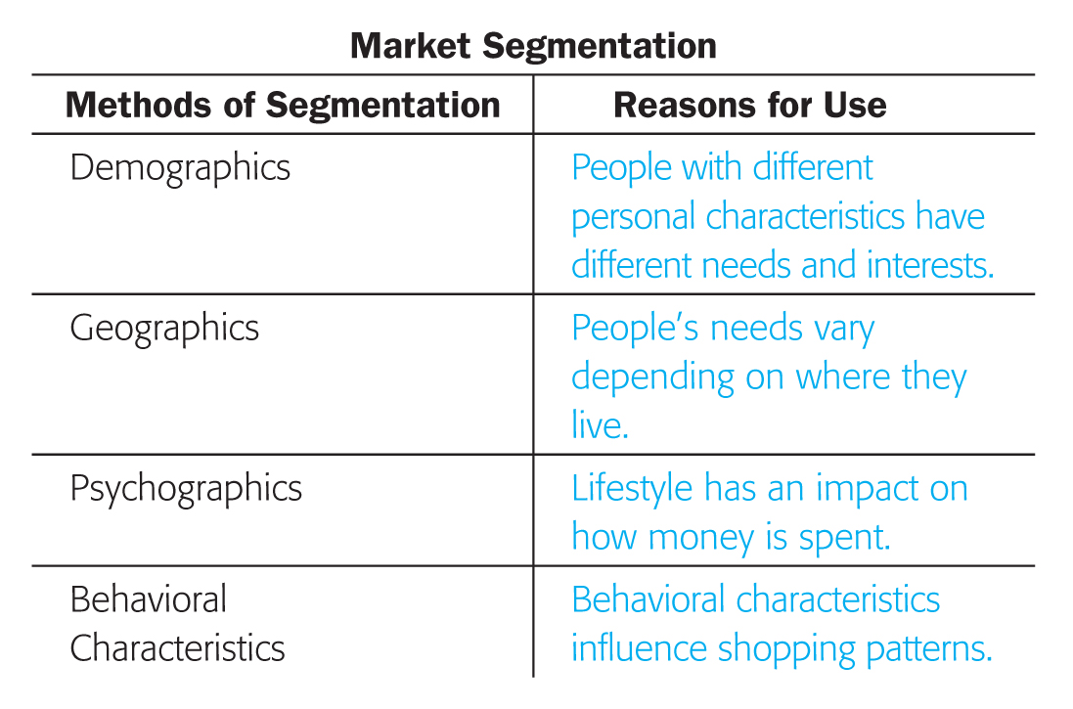
Market Segmentation

Slide 5


Market Segmentation
Identifying and Analyzing Markets
Age
Price
Market Segmentation
market segmentation
The process of classifying people who form a given market into even smaller groups.
Desired
Features

Slide 6

Market Segmentation
Identifying and Analyzing Markets
Government
Data
Private
Research
Trade
Associations
Company
Research
A company gathers data from multiple sources.

Slide 7

Market Segmentation
Types of Segmentation
Demographic
Geographic
Psychographic
Behavioral
Age
Gender
Income
Marital status
Ethnic background
Local
State
Regional
National
Global
Attitudes
Opinions
Interests
Activities
Personality
Values
Shopping Patterns
Decision-making process
demographic
Statistics that describe a population in terms of personal characteristics such as age, gender, income, marital status, and ethnic background.
psychographic
Grouping people with similar attitudes, interests, and opinions, as well as lifestyles and shared values.

Slide 8
Create Your Own
Fill this in about yourself
Demographic
Geographic
Psychographic
Behavioral
Age
Gender
Income
Marital status
Ethnic background
Local
State
Regional
National
Global
Attitudes
Opinions
Interests
Activities
Personality
Values
Shopping Patterns
Decision-making process
demographic
Statistics that describe a population in terms of personal characteristics such as age, gender, income, marital status, and ethnic background.
psychographic
Grouping people with similar attitudes, interests, and opinions, as well as lifestyles and shared values.

Slide 9

Market Segmentation
Types of Segmentation
Income
Disposable
Income
Discretionary
Income
disposable Income
Money left after taking out taxes.
discretionary income
Money left after paying for basic living necessities such as food, shelter, and clothing.

Slide 10

Market Segmentation
Types of Segmentation
Demographics
+
Psychographics
+
Geographics
=
Comprehensive
Customer Profile
geographics
Segmentation of the market based on where people live.

Slide 11

Market Segmentation
Types of Segmentation
Changing Times
+
Personal
Experiences
=
Attitudes and
Opinions

Slide 12

Market Segmentation
Types of Segmentation
80 percent of a
company’s sales...
are generated by 20 percent
of its loyal customers

Slide 13

Market Segmentation
Mass Marketing Vs. Segmentation
Mass Marketing
Advantages
Disadvantage
Economics of scale
Simplified marketing plan
Competitors can identify
unmet needs and wants
and then steal customers
mass marketing
Using a single marketing strategy to reach all customers.

Slide 14
Market Segmentation
Mass Marketing Vs. Segmentation
Niche Marketing
Advantages
Disadvantage
Extremely precise
Increased chance for
success
Cost
  Research
  Production
  Packaging
  Advertising

Slide 15
Market Segmentation
1.
Explain how segmentation can help a company increase its market share.

Slide 16
Market Segmentation
1.
Explain how segmentation can help a company increase its market share.
Market segmentation allows a company to more accurately target potential customers, thereby taking customers away from competitors who may not have done as good a job of meeting the needs of the targeted market segment.

Slide 17
Market Segmentation
2.
Define the four factors that are used to describe a target market.

Slide 18
Market Segmentation
2.
Define the four factors that are used to describe a target market.
Four factors used to describe a target market are demographics, geographics, psychographics, and behavioral characteristics.

Slide 19
Market Segmentation
3.
List the advantages and disadvantages of niche marketing.

Slide 20
Market Segmentation
3.
List the advantages and disadvantages of niche marketing.
An advantage of niche marketing is that it narrows and defines a market with extreme precision, thereby increasing the chances of success. A disadvantage is that niche marketing is expensive. Because the market is relatively small, niche marketing does not result in the economies of scale that can be obtained in mass marketing. Research is required to identify target markets and develop different marketing strategies.

Slide 21


Watch Shark Tank
While watching the show, fill out the 4Ps and DGPB for each product
Notes:
Shark Tank s2 e5 (youtube.com)
Best Of Season 14 | Shark Tank US | Shark Tank Global (youtube.com)
https://www.youtube.com/watch?v=DC8UvhBU368&t=3s

